Slide 1

Transaction Certificates Explained

Slide 2

What are Transaction Certificates?
Transaction certificates (TCs) are used in GOTS to verify a sale of GOTS goods between a certified entity and their customer.
TCs are essential for GOTS traceability, and it is required to keep all TCs from your suppliers on file for at least 5 years (2.5.2).
TCs verify the certified organic status of GOTS goods, without them products cannot be sold as GOTS.
It is the responsibility of the seller to request the TC from their certification body (CB).
Licensees should ensure they are asking for TCs from their suppliers in enough time to have them on file before the sale of GOTS goods.
TCs requested after 180 days since the first shipment may not be issued by the CB (dependent on a risk assessment).

Slide 3
Information required for TC request
The TC request form is available here: Certification resources | Fashion & Textiles | Soil Association Certification
Along with your TC request, please submit the following information:
Invoices of outgoing sales detailing the net weight of each GOTS good;
Delivery notes for outgoing sales including gross shipping weight of each GOTS good;
Input TC from your supplier verifying the incoming GOTS goods OR farm certificates and invoices for first processors.
All documentary evidence should be sent with each TC request on the same email.
GOTS TC policy is available here: Policy_for_the_Issuance_of_Transaction_Certificates_v_3.0.pdf (global-standard.org)

Slide 4
Weights explained
GROSS WEIGHT: total weight of the GOTS goods and any packaging and accessories.
NET WEIGHT: total weight of GOTS goods including any non-certified portion of the product and accessories (excluding packaging).
CERTIFIED WEIGHT: total weight of organic fibres in the finished GOTS goods (after processing).
SUPPLEMENTARY WEIGHT: non-certified accessories which are excluded from material composition, e.g zips, linings, buttons etc.

Slide 5
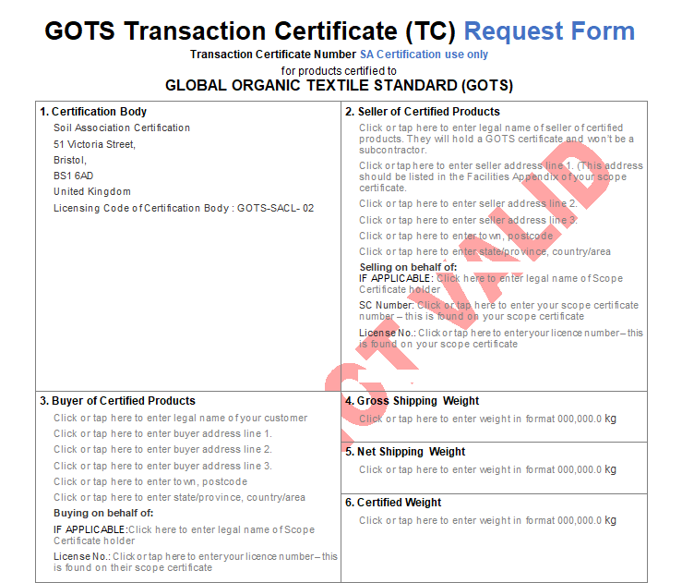
TC Request Form - Addresses
Certification body.
Seller of certified products – your business address and licence number.
Buyer of certified products – your buyers business address and licence number (if applicable).

Slide 6
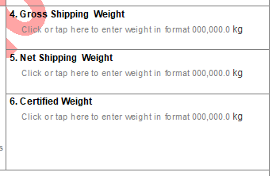
TC Request Form - Weights
Gross Shipping Weight – total gross shipping weight of GOTS goods across all shipments.
Net Shipping Weight – total net weight across certified products on all invoices.
Certified Weight – total weight of organic fibres across all certified products.

Slide 7
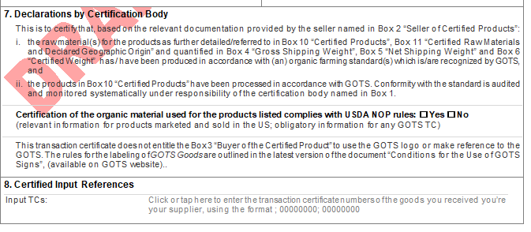
TC Request Form - Inputs
Declaration by Certification Body – to be completed by the CB. NOP compliant organic fibres must be listed on the input TC as such.
Certified Input References – input TC number(s). Please list all the TCs from your suppliers for the transactions of the materials used for the products included in this TC request.

Slide 8
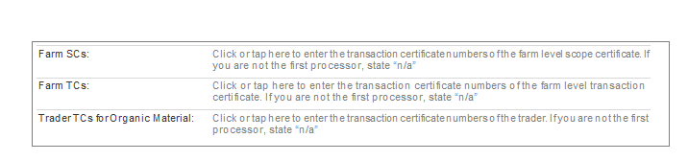
First Processor Inputs
If you are buying certified organic fibres directly from farms, not a certified GOTS entity, you will not have an input TC so will need to submit the farms organic scope certificates listing the certified fibre and the invoices evidencing the sale of organic fibres from the farm to you.

Slide 9
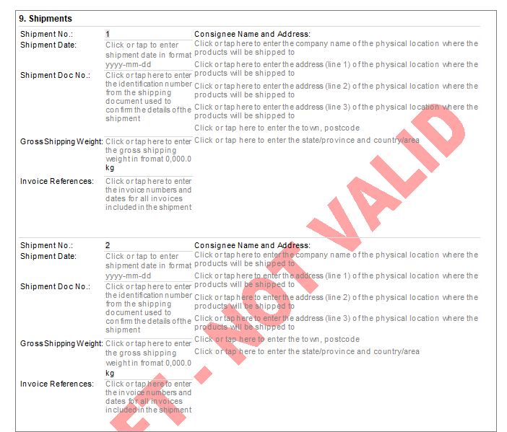
TC Request Form - Shipments
Each shipment of the GOTS goods shall be listed here and supported by delivery notes or shipping documents.
Shipment date should be evidenced on delivery notes.
Shipment document – the reference number for the delivery note.
Gross shipping weight – the total weight of the certified product plus the packaging and accessories for each shipment.
Invoice references – the invoice number for the sale of the certified products.
Consignee Name and Address – as listed on the delivery note(s).

Slide 10
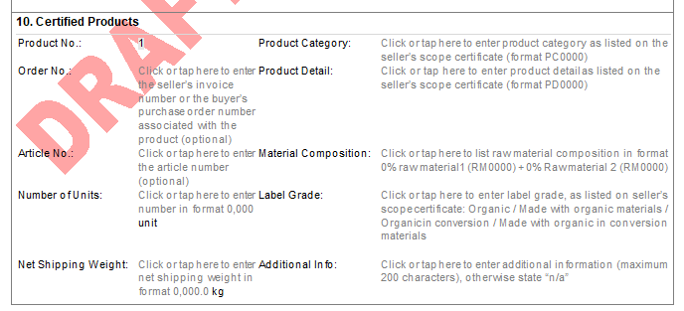
TC Request Form – Certified Products
Certified Products
Order number – invoice number for the sale of the certified products.
Article number – how the product is identified on your system e.g SKU, lot number etc.
Number of units – number of units of certified product on the invoice.
Net shipping weight – weight of the finished certified goods on that invoice.

Slide 11
TC Request Form – Certified Products
Product category – how the certified goods are listed on your GOTS scope certificate product appendix e.g womenswear
Product detail – how your product is listed on your GOTS scope certificate product appendix e.g outerwear, jackets. Please note, sales of products that are not listed on your scope certificate cannot be supported by a TC, it is important to have your products approved before they can be sold as GOTS goods.
Material composition – fibre composition of the finished goods.
Label grade – organic, made with organic materials, organic in conversion or made with organic in
conversion materials.
Additional info – any other information such as fibre quality parameters.

Slide 12
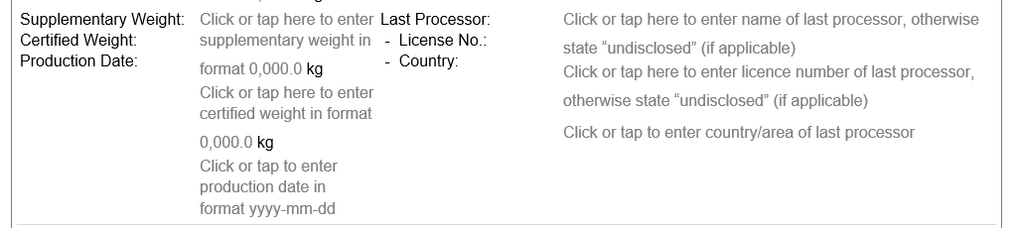
TC Request Form – Certified Products Continued
Supplementary weight – the weight of any non-certified accessories e.g linings, zips, etc.
Certified weight – the weight of the organic fibres in the GOTS goods.
Production date – if applicable, the date of processing the goods. Traders can find this on the input TC.
Last processor – if applicable, yourself, your supplier processing the goods or undisclosed if you prefer. Please include the licence number and country if listed.

Slide 13
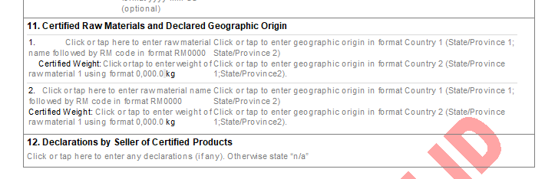
TC Request Form – Geographic Origin
Geographic Origin is mandatory on all TCs issued from 6th October 2021 as per the GOTS TC policy. This should be evidenced on the input TC. It is not possible to issue a TC without the country of origin and some countries require the state of origin as well. Full details can be found here: GOTS_Geographic_Classification_v_1.0.xlsx (live.com)
Declarations by Seller of Certified Products – any additional information such as subcontractor processing.

Slide 14
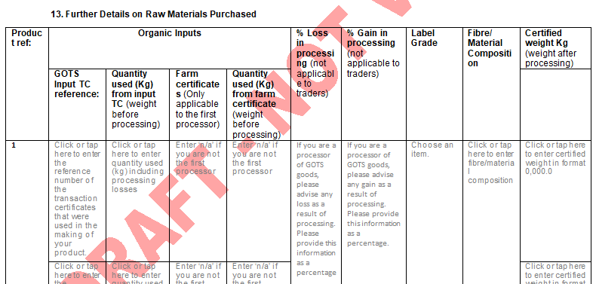
TC Request Form – Processing
Further Details on Raw Materials Purchased
Input TC per fibre, or equivalent farm certificates or invoice.
Quantity of fibre used from each input TC. This is the weight of GOTS goods from your input TC before any processing.

Slide 15
TC Request Form – Processing Continued
Further Details on Raw Materials Purchased
Processing losses or gains as a % .
The label grade of the input materials.
The fibre composition of the input materials.
The certified weight should be the quantity used from the input TC with the processing losses or gains removed or added. This is the weight from the input TC, after processing, that has gone into the finished GOTS good.

Slide 16
Supporting evidence
Invoices must include:
Certified goods identifiable as GOTS
Net weights of GOTS goods
Shipment documents must include:
Shipment dates
Reference to invoices
Certified goods identifiable as GOTS
Gross weights for GOTS goods
Input TCs must include:
Country of origin information (and state if required)
Verified quantity of input GOTS materials

Slide 17
Resources
Soil Association – Certification resources
https://www.soilassociation.org/certification/fashion-textiles/certification-resources/
GOTS Transaction Certificate Policy
https://global-standard.org/images/resource-library/documents/certificate-policies-and-templates/Policy_for_the_Issuance_of_Transaction_Certificates_v_3.0.pdf

